Slide 1


Unit-1
CHAMELI DEVI GROUP OF INSTITUTIONS, INDORE
Introduction to Algorithms
Prepared By:
Mr Sumeet Kothari
Asst. Professor
Department of Computer Science & Engineering

Slide 2
Algorithm
Algorithm is a step-by-step procedure, which defines a set of instructions to be executed in a certain order to get the desired output.
Algorithms are generally created independent of underlying languages, i.e. an algorithm can be implemented in more than one programming language.

Slide 3
Properties of Algorithm
Unambiguous − Algorithm should be clear and unambiguous. Each of its steps (or phases), and their inputs/outputs should be clear and must lead to only one meaning.
Range of Input − The range of input should be specified. This is because the algorithm is input driven and if the range of the input is not been specified then algorithm can go in an infinite state.

Slide 4
Properties of Algorithm
Finiteness − Algorithms must terminate after a finite number of steps.
Speed− The algorithms are written using some specific ideas .But such algorithms should be efficient and should produce the output with fast speed.

Slide 5
Properties of Algorithm
Multiplicity − The same algorithms can be represented in several different ways. Similarly for solving the same problem we can write several different algorithms.

Slide 6
Algorithm Design Techniques
Divide and Conquer Approach
Greedy Technique
Dynamic Programming
Backtracking Algorithm
Branch and Bound

Slide 7
Divide and Conquer Approach
It is a top-down approach. The divide & conquer techniques involve three steps:
Divide the original problem into a set of sub problems.
Solve every sub problem individually, recursively.
Combine the solution of the sub problems (top level) into a solution of the whole original problem.

Slide 8
Greedy Technique
An algorithm is designed to achieve optimum solution for a given problem.
In greedy algorithm approach, decisions are made from the given solution domain. As being greedy, the closest solution that seems to provide an optimum solution is chosen.

Slide 9
Counting Coins
This problem is to count to a desired value by choosing the least possible coins
The greedy approach forces the algorithm to pick the largest possible coin.
If we are provided coins of ₹ 1, 2, 5 and 10 and we are asked to count ₹ 18 then the greedy procedure will be −

Slide 10
Counting Coins Contd
Select one ₹ 10 coin, the remaining count is 8
Then select one ₹ 5 coin, the remaining count is 3
Then select one ₹ 2 coin, the remaining count is 1
And finally, the selection of one ₹ 1 coins solves the problem
For this count we need to pick only 4 coins.

Slide 11
Counting Coins Contd
For the currency system, where we have coins of 1, 7, 10 value, counting coins for value 15
It may use more coins than necessary.
For example, the greedy approach will use 10 + 1 + 1 + 1 + 1 + 1, total 6 coins.
Whereas the same problem could be solved by using only 3 coins (7 + 7 + 1).

Slide 12
Dynamic Programming
Dynamic programming approach is similar to divide and conquer in breaking down the problem into smaller
But unlike, divide and conquer, these sub-problems are not solved independently.
Rather, results of these smaller sub-problems are remembered and used for similar or overlapping sub-problems.

Slide 13
Dynamic Programming
Dynamic programming is used where we have problems, which can be divided into similar sub-problems, so that their results can be re-used.
Mostly, these algorithms are used for optimization.
Before solving the in-hand sub-problem, dynamic algorithm will try to examine the results of the previously solved sub-problems.

Slide 14
Backtracking Algorithm
Backtracking Algorithm tries each possibility until they find the right one.
It is a depth-first search of the set of possible solution. During the search, if an alternative doesn't work, then backtrack to the choice point, the place which presented different alternatives, and tries the next alternative.

Slide 15
Branch and Bound
In Branch & Bound algorithm a given sub problem, which cannot be bounded, has to be divided into at least two new restricted sub problems. Branch and Bound algorithm are methods for global optimization in non-convex problems.

Slide 16
Algorithm Analysis
Computing Best case , Worst case and Average case efficiencies
Measuring Space Complexity
Measuring Input Size
Analysis Framework
Measuring Time Complexity
Measuring Running Time
Computing Order of Growth of Algorithms

Slide 17
Algorithm Analysis
The efficiency of an algorithm is decided by measuring the performance of an algorithm.
We can measure the performance of an algorithm by computing two factors :-
Time Complexity
Space Complexity

Slide 18
Space Complexity
It is the amount of memory used by the algorithm (including the input values to the algorithm) to execute and produce the result.
There are 2 types of components that contribute to the Space complexity :-
Fixed part
Variable Part

Slide 19
Fixed Part Space Complexity
It includes spaces for
Instructions
Variables
Array Size
Space for constants

Slide 20
Variable Part Space Complexity
The variables whose size is dependent upon the particular problem instance being solved.
The control statements (for ,do ,while ) are used to solve such instance.
Recursion stack for handling recursive call.

Slide 21
Memory Usage while Execution
Instruction Space :- It's the amount of memory used to save the compiled version of instructions.
Data Space :- Amount of space used by the variables and constants.

Slide 22
Memory Usage while Execution
Environmental Stack :- Sometimes an algorithm(function) may be called inside another algorithm(function). In such a situation, the current variables are pushed onto the system stack, where they wait for further execution and then the call to the inside algorithm(function) is made.

Slide 23
Memory Usage while Execution
For example, If a function A() calls function B() inside it, then all the variables of the function A() will get stored on the system stack temporarily, while the function B() is called and executed inside the function A().

Slide 24
Space Complexity
But while calculating the Space Complexity of any algorithm, we usually consider only Data Space and we neglect the Instruction Space and Environmental Stack.

Slide 25
Calculate Space Complexity
{
int z = a + b + c;
return(z);
}

Slide 26
Solution
In the above expression, variables a, b, c and z are all integer types, hence they will take up 4 bytes each, so total memory requirement will be (4(4) + 4) = 20 bytes, this additional 4 bytes is for return value. And because this space requirement is fixed for the above example, hence it is called Constant Space Complexity.

Slide 27
Calculate Space Complexity
int sum(int a[], int n)
{
int x = 0; // 4 bytes for x
for(int i = 0; i < n; i++) // 4 bytes for i
{
x = x + a[i];
}
return(x);
}

Slide 28
Solution
In the above code, 4*n bytes of space is required for the array a[] elements.
4 bytes each for x, n, i and the return value.
Hence the total memory requirement will be (4n + 16), which is increasing linearly with the increase in the input value n, hence it is called as Linear Space Complexity.

Slide 29
Time Complexity
It’s a function describing the amount of time required to run an algorithm in terms of the size of the input.
"Time" can mean the number of memory accesses performed, the number of comparisons between integers, the number of times some inner loop is executed, or some other natural unit related to the amount of real time the algorithm will take.

Slide 30
For(i=1;i<=n;i++)
{
For(j=1;j<=n;j++)
cout<<cs;
}

Slide 31
Asymptotic Notations
Execution time of an algorithm depends on the instruction set, processor speed, disk I/O speed, etc. Hence, we estimate the efficiency of an algorithm asymptotically.
Time function of an algorithm is represented by T(n), where n is the input size.

Slide 32
Different types of Asymptotic notations
O − Big Oh
Ω − Big omega
θ − Big theta

Slide 33
O: Asymptotic Upper Bound
‘O’ (Big Oh) is the most commonly used notation.
A function f(n) can be represented is the order of g(n) that is O(g(n)), if there exists a value of positive integer n as n₀ and a positive constant c such that −
f(n)⩽c*g(n) for n>n0 in all case
Hence, function g(n) is an upper bound for function f(n), as g(n) grows faster than f(n).

Slide 34
Ω: Asymptotic Lower Bound
We say that f(n)=Ω(g(n))f(n)=Ω(g(n)) when there exists constant c that f(n)⩾c*g(n) for all sufficiently large value of n.
Here n is a positive integer.
It means function g is a lower bound for function f; after a certain value of n, f will never go below g.

Slide 35
θ: Asymptotic Tight Bound
We say that f(n)=θ(g(n))f(n)=θ(g(n)) when
there exist constants c₁ and C₂ that
c1.g(n)⩽f(n)⩽c2.g(n) for all sufficiently large value of n.
Here n is a positive integer.
This means function g is a tight bound for function f.

Slide 36
Apriori and Apostiari Analysis
Apriori analysis means, analysis is performed prior to running it on a specific system. This analysis is a stage where a function is defined using some theoretical model. Hence, we determine the time and space complexity of an algorithm by just looking at the algorithm rather than running it on a particular system with a different memory, processor, and compiler.

Slide 37
Apriori and Apostiari Analysis
Apostiari analysis of an algorithm means we perform analysis of an algorithm only after running it on a system. It directly depends on the system and changes from system to system.

Slide 38
Recurrence Relation
A recurrence is an equation that describes a function in terms of its values on smaller inputs.
To solve a Recurrence Relation means to obtain a function defined on the natural numbers that satisfy the recurrence.

Slide 39
Methods for solving Recurrence
Substitution Method
Forward Substitution
Backward Substitution
Recursion Tree Method
Master Method

Slide 40
Substitution Method
The Substitution Method Consists of two main steps:
Guess the Solution.
Use the mathematical induction to find the boundary condition and shows that the guess is correct.

Slide 41
Backward Substitution
It means to expand the recurrence and express it as a summation of terms of n and initial condition.

Slide 42
Backward Substitution
Example1: Consider the Recurrence
T (n) = 1 if n=1
= 2T (n-1) if n>1
Example2: Consider the Recurrence
T (n) = T (n-1) +1 and T (1) = θ (1).

Slide 43
Recursion Tree Method
Recursion Tree Method is a pictorial representation of an iteration method which is in the form of a tree where at each level nodes are expanded.
In general, we consider the second term in recurrence as root.
It is useful when the divide & Conquer algorithm is used.

Slide 44
Solve
Example1: Consider the following recurrence
T (n) = 2T(n/2) + n²
Example 2: Consider the following recurrence
T (n) = 4T(n/2) +n
Example 3: Consider the following recurrence
T (n) = T(n/3) + T(2n/3) + n

Slide 45
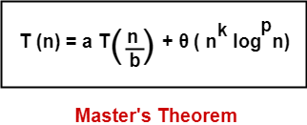
Master Method
The Master Method is used for solving the following types of recurrence
where a >= 1, b > 1, k >= 0 and p is a real number

Slide 46
Master Method
In Master’s Theorem, we compare ‘a’ with ‘b^{k}‘ and then follow the following cases-
Case-01:
If a > b^{k}, then T(n) = θ (n^{log}_{b}ª)
Case-02:
If a = b^{k} and-
If p < -1, then T(n) = θ (n^{log}_{b}ª)
If p = -1, then T(n) = θ (n^{log}_{b}ª.log²n)
If p > -1, then T(n) = θ (n^{log}_{b}ª.log^{p+1}n)

Slide 47
Master Method
Case-03:
If a < b^{k} and-
If p < 0, then T(n) = O (n^{k})
If p >= 0, then T(n) = θ (n^{k}log^{p}n)

Slide 48
Problem-01
Solve the recurrence relation using Master’s Theorem-
T(n) = 2T(n/2) + n
On comparing the given recurrence relation with-
T(n) = aT(n/b) + θ (n^{k}log^{p}n)
we have-
a = 2 b = 2 k = 1 p = 0

Slide 49
Problem-01
Now, a = 3 and b^{k} = 2² = 4.
Clearly, a < b^{k}
So, we follow case-03.
Since p = 0, so we have-
T(n) = θ (n^{k}log^{p}n)
T(n) = θ (n²log⁰n)
Thus,
T(n) = θ (n²)

Slide 50
Problem-02
Solve the recurrence relation using Master’s Theorem- T(n) = 2T(n/2) + nlogn
On comparing the given recurrence relation with-
T(n) = aT(n/b) + θ (n^{k}log^{p}n)
we have-
a = 2 b = 2 k = 1 p = 1

Slide 51
Problem-02
Now, a = 2 and b^{k} = 2¹ = 2.
Clearly, a = b^{k}
So, we follow case-02.
Since p = 1, so we have-
T(n) = θ (n^{log}_{b}ª.log^{p+1}n)
T(n) = θ (n^{log}₂².log¹⁺¹n)
Thus,
T(n) = θ (nlog²n)

Slide 52
Problem-03
Solve the recurrence relation using Master’s Theorem-
T(n) = 2T(n/4) + n^{0.51}
On comparing the given recurrence relation with-
T(n) = aT(n/b) + θ (n^{k}log^{p}n)
we have-
a = 2 b = 4 k = 0.51 p = 0

Slide 53
Problem-03
Now, a = 2 and b^{k} = 4^{0.51} = 2.0279
Clearly, a < b^{k}
So, we follow case-03.
Since p = 0, so we have-
T(n) = θ (n^{k}log^{p}n)
T(n) = θ (n^{0.51}log⁰n)
Thus,
T(n) = θ (n^{0.51})

Slide 54
Problem-04
Solve the recurrence relation using Master’s Theorem-
T(n) = √2T(n/2) + logn
On comparing the given recurrence relation with-
T(n) = aT(n/b) + θ (n^{k}log^{p}n)
we have-
a = √2 b = 2 k = 0 p = 1

Slide 55
Problem-04
Now, a = √2 = 1.414 and b^{k} = 2⁰ = 1.
Clearly, a > b^{k}
So, we follow case-01.
So we have-
T(n) = θ (n^{log}_{b}ª)
T(n) = θ (n^{log}₂^{√2})
T(n) = θ (n^{1/2})
Thus,
T(n) = θ (√n)

Slide 56
Heap Sort
Heap sort is a sorting method discovered by J.W.J. Williams .It Works in 2 stages:-
Heap Construction
Deletion of maximum key.

Slide 57
Heap sort Algorithm
Algorithm Build_Max_Heap(A[n])
{
//Problem Description: This algorithm builds the heap satisfying maximum heap property
A.Heapsize=A.Heaplength;
for i <- [length[A]/2] down to 1
Max_heapify(A,i);
}

Slide 58
Heap sort Algorithm
Algorithm Max_Heapify(A[n], i)
{
L=2*i;
R=2*i+1;
if(L<=A.Heapsize and A[L]>A[i])
Largest=L;
else
Largest=i;

Slide 59
Heap sort Algorithm
if(R<=A.Heapsize and A[R]>A[Largest])
Largest=R;
if( A[Largest] ≠ A[i])
{
Swap(A[i] ,A[Largest] );
Max_heapify(A,Largest);
}

Slide 60
Merge sort Algorithm
Merge _sort(A, p, r)
{ if(p<r)
{
q=[(p+r) /2];
Merge _sort(A, p, q);
Merge _sort(A, q+1, r);
Merge(A , p, q ,r );
}
}

Slide 61
Merge sort Algorithm
Merge (A, p, q, r)
{
n1=q-p+1; n2=r-q;
let L1=[1-----n1+1] and L2=[1------n2+1];
for(i =1 to n1)
L[i]=A[p+i-1];
for(j =1 to n2)
R[j]=A[q+j];
L[n1+1]=∞ R[n2+1]=∞

Slide 62
Merge sort Algorithm
i=1 , j=1;
for(k=p to r)
if(L[i]<R[j])
A[k]=L[i];
i=i+1;
else
A[k]=R[j]
J=j+1;
}

Slide 63
Normal Matrix Multiplication
void multiply(int A[][N], int B[][N], int C[][N])
{ for (int i = 0; i < N; i++)
{ for (int j = 0; j < N; j++)
{ C[i][j] = 0;
for (int k = 0; k < N; k++)
{ C[i][j] += A[i][k]*B[k][j];
}
}
}
}
Time Complexity of above method is O(N³).

Slide 64
Divide and Conquer
Following is simple Divide and Conquer method to multiply two square matrices. 1) Divide matrices A and B in 4 sub-matrices of size N/2 x N/2 as shown in the below diagram. 2) Calculate following values recursively.
ae + bg, af + bh, ce + dg and cf + dh.

Slide 65
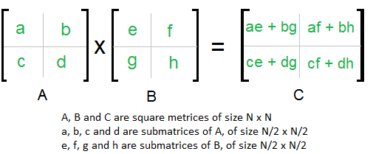
Divide and Conquer

Slide 66
Divide and Conquer
In the above method, we do 8 multiplications for matrices of size N/2 x N/2 and 4 additions. Addition of two matrices takes O(N²) time. So the time complexity can be written as
T(N) = 8T(N/2) + O(N²)
From Master's Theorem, time complexity of above method is O(N³)

Slide 67
Strassen’s Matrix Multiplication
In the above divide and conquer method, the main component for high time complexity is 8 recursive calls. The idea of Strassen’s method is to reduce the number of recursive calls to 7. Strassen’s method is similar to above simple divide and conquer method in the sense that this method also divide matrices to sub-matrices of size N/2 x N/2

Slide 68
Strassen’s Matrix Multiplication
In Strassen’s method, the four sub-matrices of result are calculated using following formulae.

Slide 69
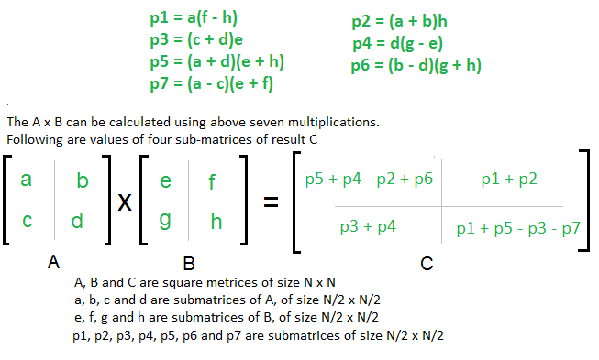
Strassen’s Matrix Multiplication

Slide 70
Time Complexity of Strassen’s Method
Addition and Subtraction of two matrices takes O(N²) time.
So time complexity can be written as
T(N) = 7T(N/2) + O(N²)
From Master's Theorem, time complexity of above method is O(N^{Log7}) which is approximately O(N^{2.8074})

Slide 71
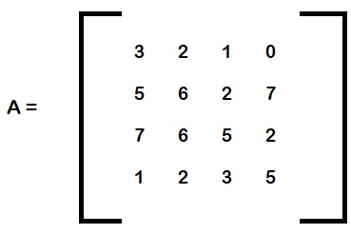
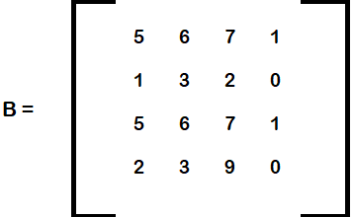
Example of 4×4 Strassen’s matrix
Consider a matrix which is of order 4×4, we need to find its multiplication.

Slide 72
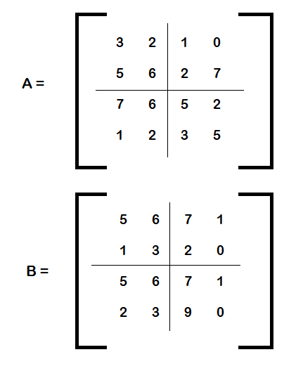
Example of 4×4 Strassen’s matrix
Step 1: Firstly divide A & B into 4 sub equivalent parts.

Slide 73
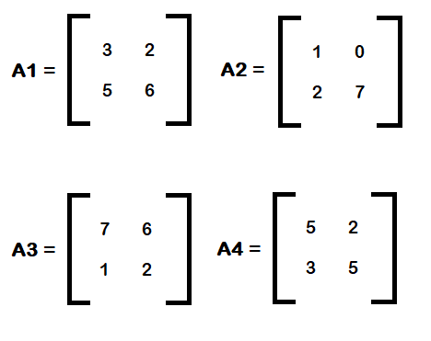
Example of 4×4 Strassen’s matrix
Step 2: Write this matrix in the form of four 2×2 matrices and name them accordingly like A1, A2, A3, A4, B1, B2, B3, B4

Slide 74
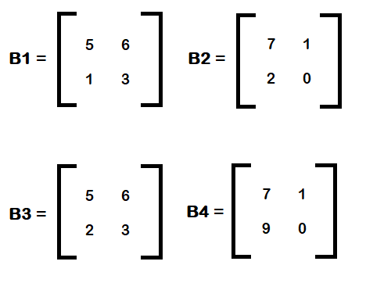
Example of 4×4 Strassen’s matrix

Slide 75
Example of 4×4 Strassen’s matrix
Step 3: Finally we need to find the multiplications of these matrices one by one in such a way that
C1 = A1.B1
C2 = A2.B2
C3 = A3.B3
C4 = A4.B4

Slide 76
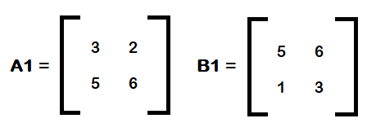
Example of 4×4 Strassen’s matrix
So for C1, take consider the matrix A1 & B1
We know C1 = A1.B1

Slide 77
Example of 4×4 Strassen’s matrix
So,
P1= a*(f – h) = 3*(6-3) = 9
P2 = h*(a + b) = 3*(3+2) = 15
P3 = e*(c + d) = 5*(5+6) = 55
P4 = d*(g – e) = 6*(1-5) = -24
P5 = (a + d)*(e + h)= (3+6)*(5+3) = 72
P6 = (b – d)*(g + h)= (2-6)*(1+3) = -16
P7 = (a – c)*(e + f)= (3-5)*(5+6) = -22

Slide 78
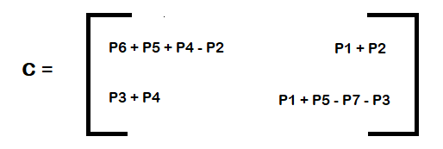
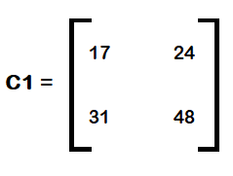
Example of 4×4 Strassen’s matrix
We know,
So here,

Slide 79
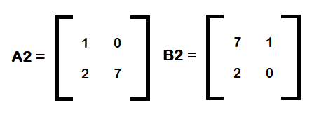
Example of 4×4 Strassen’s matrix
Now for C2, take consider the matrix A2 & B2
We know C2 = A2.B2

Slide 80
Example of 4×4 Strassen’s matrix
Similarly here we have,
P1= a * ( f – h ) = 1
P2 = h * ( a + b ) = 0
P3 = e * ( c + d ) = 63
P4 = d * ( g – e ) = -35
P5 = ( a + d ) * ( e + h ) = 56
P6 = ( b – d ) * ( g + h ) = -14
P7 = ( a – c ) * ( e + f ) = -8

Slide 81
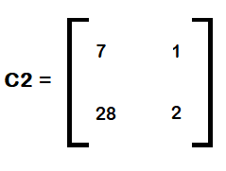
Example of 4×4 Strassen’s matrix
Similarly,
So, C2 becomes,

Slide 82
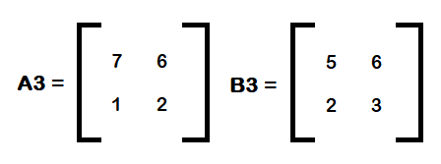
Example of 4×4 Strassen’s matrix
For C3, We have to consider A3 & B3 and implement it in the form of C3=A3.B3.
Now we have to find P1, P2…..P7
P1= a * ( f – h ) = 21
P2 = h * ( a + b ) = 39
P3 = e * ( c + d ) = 15
P4 = d * ( g – e ) = -6

Slide 83
Example of 4×4 Strassen’s matrix
P5 = ( a + d ) * ( e + h ) = 72
P6 = ( b – d ) * ( g + h ) = 20
P7 = ( a – c ) * ( e + f ) = 66
Now we have to find C,

Slide 84
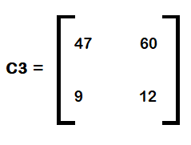
Example of 4×4 Strassen’s matrix
So, C3 becomes

Slide 85
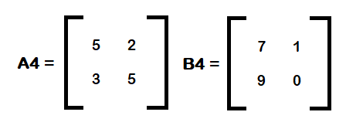
Example of 4×4 Strassen’s matrix
Finally we need to find C4 which will be equivalent to C4=A4.B4
So consider A4 & B4

Slide 86
Example of 4×4 Strassen’s matrix
Finally find P1, P2….P7
P1= a * ( f – h ) = 5
P2 = h * ( a + b ) = 0
P3 = e * ( c + d ) = 56
P4 = d * ( g – e ) = 10
P5 = ( a + d ) * ( e + h ) = 70
P6 = ( b – d ) * ( g + h ) = -27
P7 = ( a – c ) * ( e + f ) = 16

Slide 87
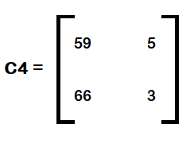
Example of 4×4 Strassen’s matrix
Now we have find C,
Finally C4 will be equal to,

Slide 88
Thank you

